Slide 1
PROJECT TITLE
CAPSTONE PROJECT
Presented By:
Visalakshi V - College of Engineering Guindy – Department of Manufacturing Engineering

Slide 2
OUTLINE
Problem Statement
Proposed System/Solution
System Development Approach
Algorithm & Deployment
Result
Conclusion
Future Scope
References

Slide 3
Problem Statement
Maintenance of Industrial Machines is crucial for a Manufacturing Company. Machine Failure can be predicted by certain parameters like tool wear, rotational speed, heat dissipation and torque. Machines can be fitted with sensors which collect data for these parameters. This sensor data must be analysed to identify patters that precede a failure. The crucial part is to create a classification model that can predict the type of failure is (e.g., tool wear, heat dissipation, power failure). This will enable proactive maintenance, reducing downtime and operational costs.

Slide 4
Proposed Solution
The proposed system aims to address the challenge of predicting machine failures to minimise unplanned downtimes and improve operational efficiency. This involves leveraging data analytics and machine learning techniques to forecast failure patterns accurately. The solution will consist of the following components:
Data Collection:
Gather historical data on machine failures, including air temperature, process temperature, rotational speed, torque, tool wear and other relevant factors.
Utilize real-time data sources to enhance prediction accuracy.
Data Preprocessing:
Clean and preprocess the collected data to handle missing values, outliers, and inconsistencies.
Feature engineering to extract relevant features from the data that might cause machine failure.
Machine Learning Algorithm:
Implement a machine learning algorithm, either manually or IBM AutoAI (e.g. Random Forest, XGBoost, Support Vector Machine (SVM)), to predict machine failures based on historical patterns.
Train the model on labelled historical data.
Deployment:
Create a deployment space in IBM Watson Studio.
Deploy the most efficient ML algorithm on the deployment space created.
Evaluation:
Assess the model's performance using appropriate metrics such as Accuracy, Precision, Confusion matrix or other relevant metrics.
Fine-tune the model based on feedback and continuous monitoring of prediction accuracy.
Result: A reliable machine failure prediction is obtained, facilitating predictive maintenance.

Slide 5
System Approach
System requirements
Hardware Requirements:
A system with a minimum of 8 GB RAM
Internet connectivity
Software Requirements:
Operating System: Windows 10/Linux/macOS
IBM Cloud Services:
IBM Watson Studio
IBM Watson Machine Learning
IBM Cloud Object Storage
Library required to build the model
pandas – Data preprocessing
numpy – Numerical computations
scikit-learn – Machine learning models & evaluation
matplotlib, seaborn – Data visualization
imblearn – Handling imbalanced datasets (e.g., SMOTE)
xgboost / lightgbm – Advanced classifiers
requests – API interaction
joblib / pickle – Model saving & loading

Slide 6
Algorithm & Deployment
Algorithm Selection:
Random Forest Classifier is best suited for this project because it can handle high-dimensional sensor data. It reduces overfitting by averaging multiple decision trees. It is highly accurate, thus facilitating predictive maintenance of complex machines.
Data Input:
Inputs used by the algorithm: Air temperature, Process temperature, Rotational speed, Torque and Tool wear.
Training Process:
Data from Kaggle is uploaded to IBM Watson Studio.
IBM AutoAI generates Pipelines using different algorithms and tunes hyperparameters using grid search and cross-validation.
The various models are ranked based on accuracy and the model with the best performance is selected and deployed.
Prediction Process:
Detail how the trained algorithm makes predictions for future bike counts. Discuss any real-time data inputs considered during the prediction phase.
The input file structured exactly like the original dataset used in training excluding the label column (Failure type) is uploaded in the test module.
Predictions are run by IBM cloud and the results obtained are in percentage and also in downloadable JSON file format.

Slide 7
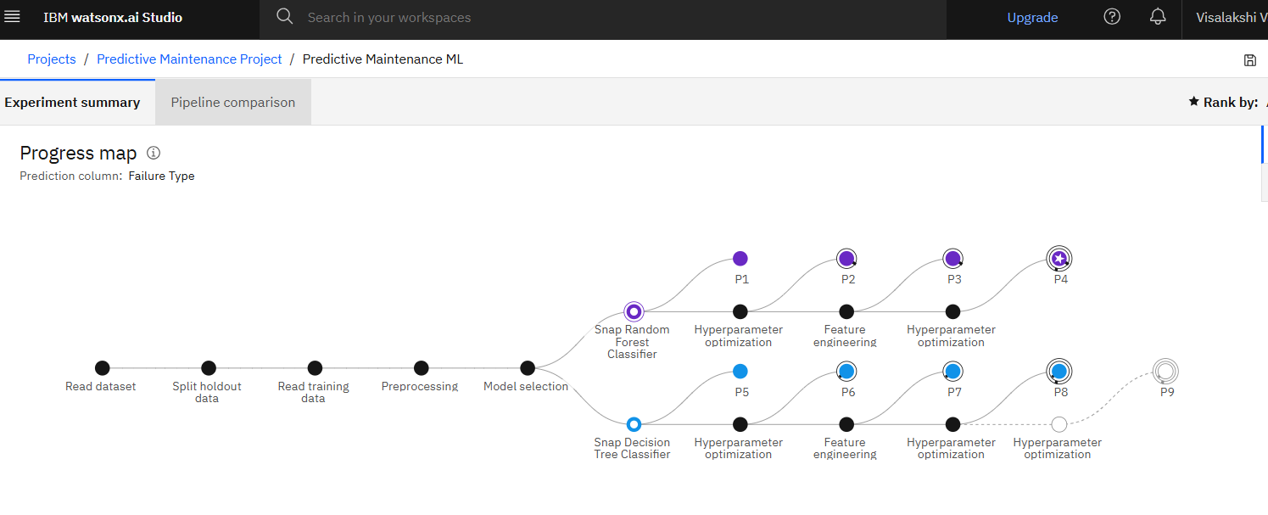
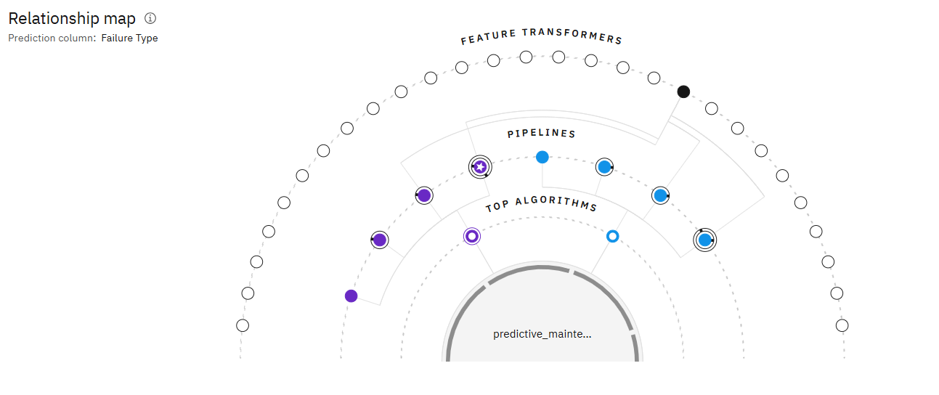
Auto AI Machine learning pipeline

Slide 8
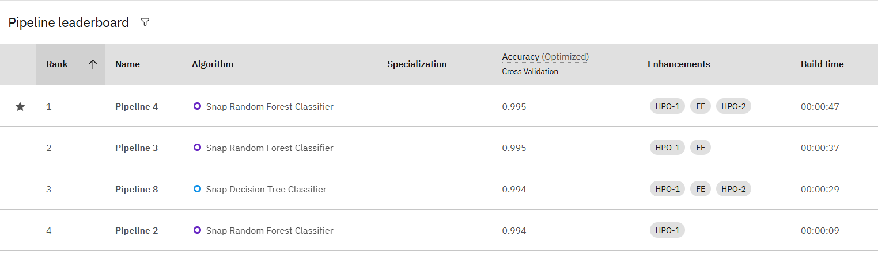
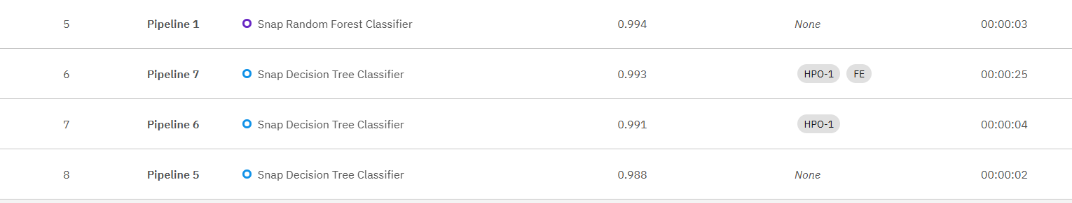
I have choosen pipeline four due to its high accuracy and enhancements for my predictive maintenance project.

Slide 9
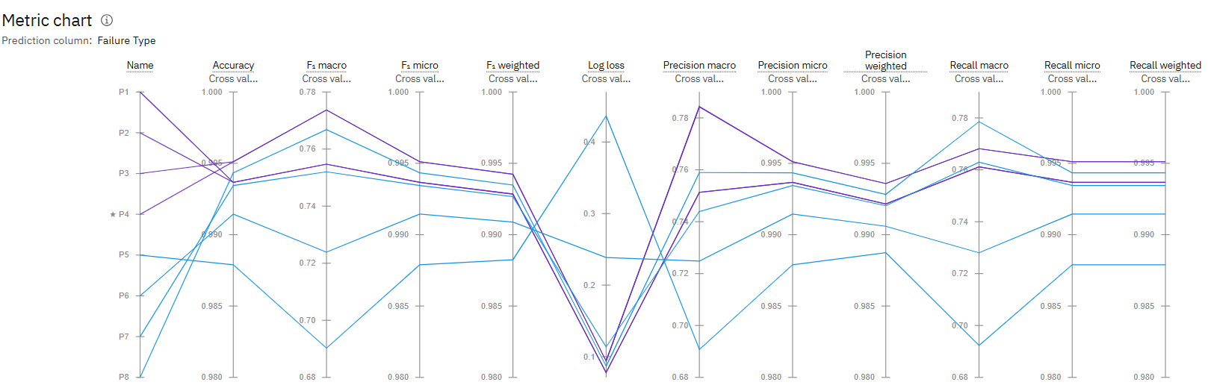
Pipeline comparison

Slide 10
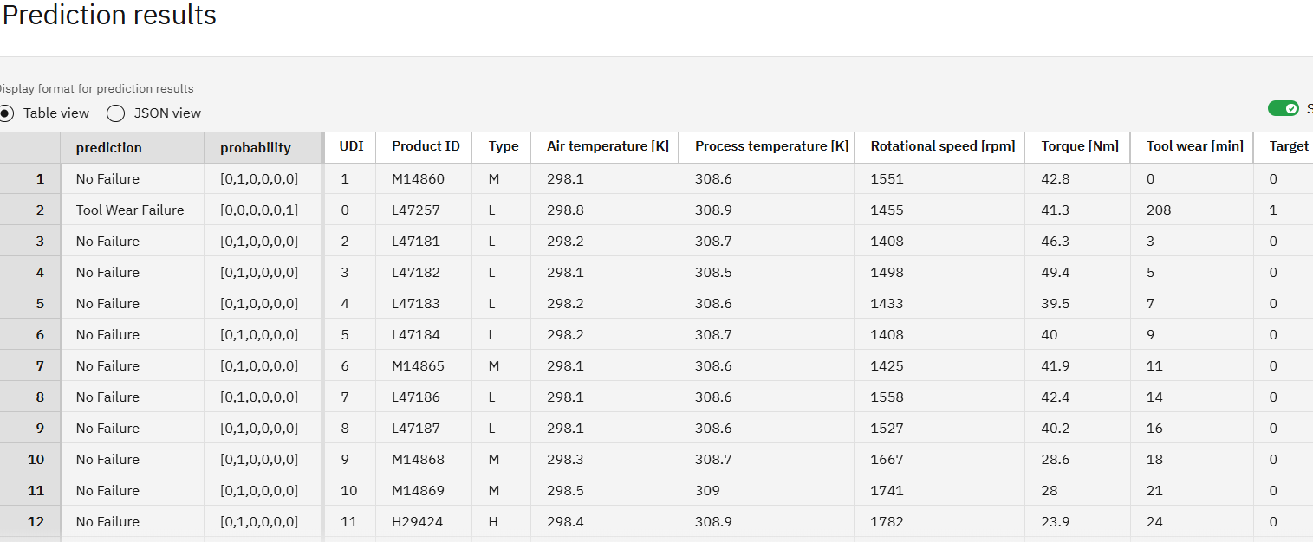
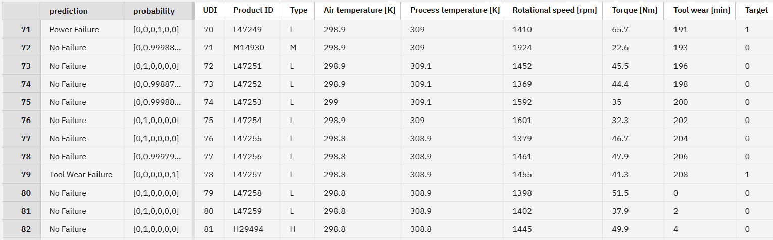
Result
Present the results of the machine learning model in terms of its accuracy and effectiveness in predicting bike counts. Include visualizations and comparisons between predicted and actual counts to highlight the model's performance.

Slide 11
Conclusion
Machine Failures like tool wear, power failure, overstrain failure, and random failures are predicted accurately using this Predictive Maintenance Machine Learning model developed using IBM AutoAI services. Challenges encountered during the implementation of this project were proper formatting of the input data, selecting the most accurate Machine learning algorithm and API configuration errors. These challenges were overcome to produce a precise predictive maintenance model.

Slide 12
Future scope
Advancements in Artificial intelligence can be integrated with Internet of things (IoT), Edge computing, Cloud computing, Computerized Maintenance Management System (CMMS), Human-Machine Interfaces (HMI) and Automation Systems to actually perform the predictive maintenance in real time.
Prescriptive maintenance can be executed using machine data, Artificial intelligence, and Machine learning to predict equipment failures and recommend specific actions to prevent them. Instead of simply predicting when a failure might occur, it offers instructions on what maintenance tasks to perform and when, thus improving performance and minimizing downtime.

Slide 13
References
https://www.ibm.com/cloud/watson-studio
https://dataplatform.cloud.ibm.com/docs/content/wsj/autoai/overview.html
https://dataplatform.cloud.ibm.com/docs/content/wsj/analyze-data/autoai-create-experiment.html
https://dataplatform.cloud.ibm.com/docs/content/wsj/predictive-modeler/predictive-modeler-deploy.html
https://cloud.ibm.com/apidocs/machine-learning
https://www.kaggle.com/datasets/shivamb/machine-predictive-maintenance-classification

Slide 14
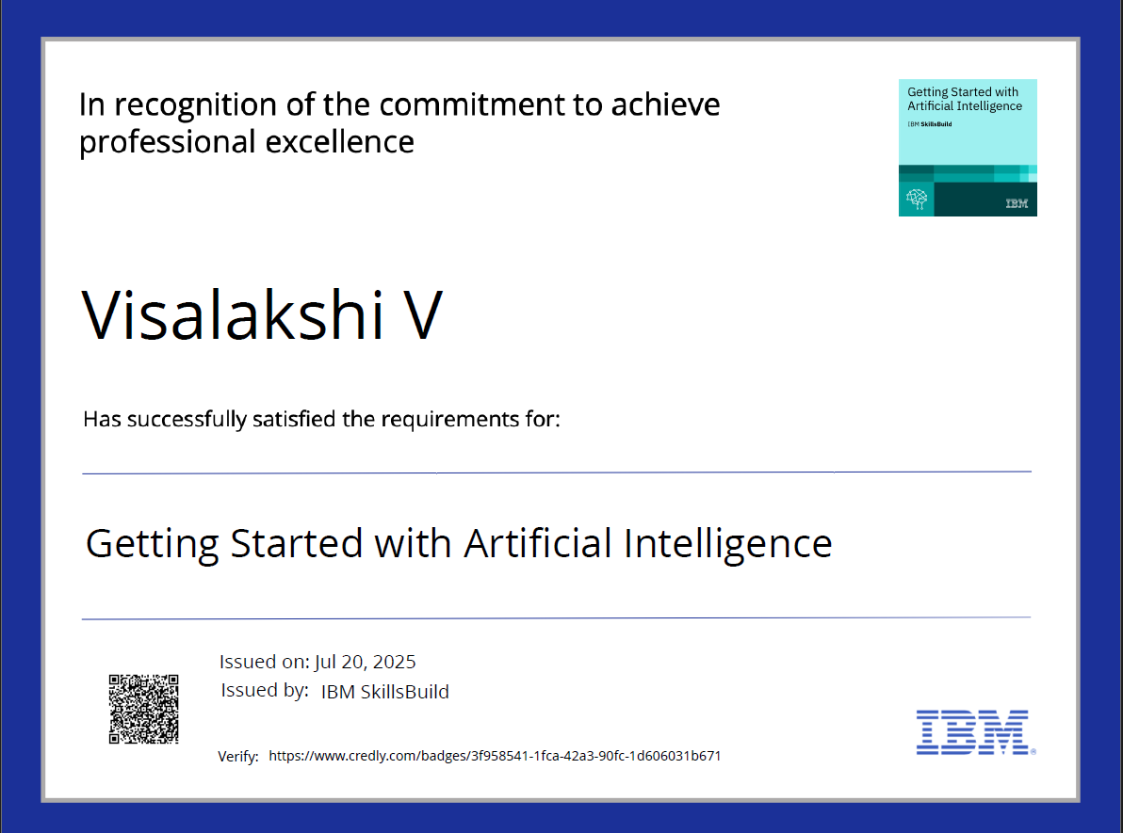
IBM Certifications

Slide 15
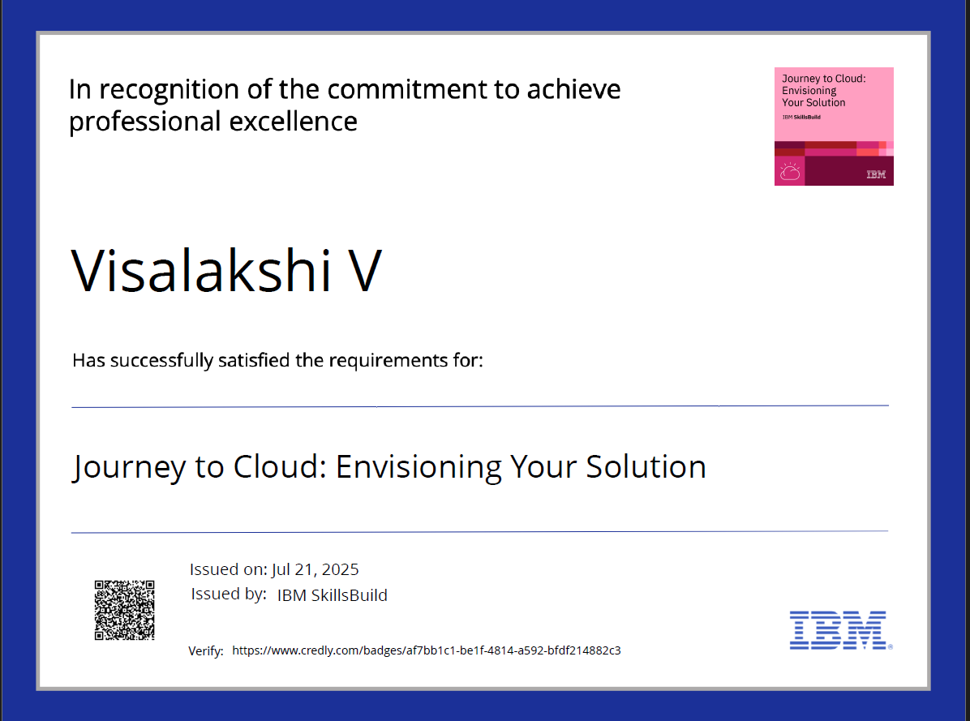
IBM Certifications

Slide 16
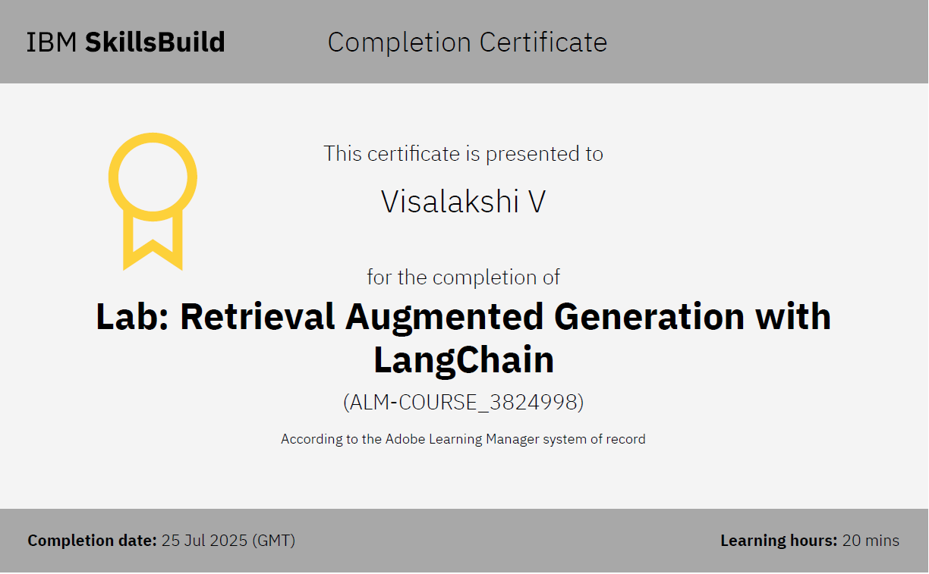
IBM Certifications

Slide 17
THANK YOU

